Slide 1
ASP.Net Web Applications
INFO 1182 / CS 1182
Using C#

Slide 2
Two types of Web Sites
All about the content
Static
Content does not change
Dynamic
Content changes based on use

Slide 3
Static Web Content
Static
Content is not changed easily
“Code” must be changed to change content.
Must have edit files permission on the server.

Slide 4
Dynamic Web Content
Dynamic
Content changes without changing the code
Started being done with CGI
Executes compiled code for each request.
Inefficient because each web call fires one program.
Dynamic Languages
PHP
ASP
JSP
Others…

Slide 5
Web Application Layers
Behavior
JavaScript
Client-side
Presentation
CSS
HTML ≤ 4
Structured Code (Content)
HTML 5, XHTML, XML
Application Logic
PHP, ASP, JSP,
Cold Fusion,
Ruby, etc.
Server-side
Code
Data Access Layer
Data
SQL, Files, etc.

Slide 6
ASP.Net != ASP
ASP
Older
HTML and Code interweaved
Like PHP
ASP.Net
Newer
HTML and Code separated
Leverages .Net Framework

Slide 7
Types of Web Projects
Web Site
Complied as needed
Web Application
Precompiled
MVC
Model-View-Controller Design Pattern

Slide 8
Two main types of files
.ASPX
Like a WPF form it contains the GUI part of the app.
.ASPX.{Language} (CS, VB, FS)
This is the Code-Behind file that contains all of the code to edit.

Slide 9
Get Vs. Post
Web Applications work of Verbs
Most common are GET and POST
GET
Information is passed in the URL
POST
Information is passed in the Message

Slide 10
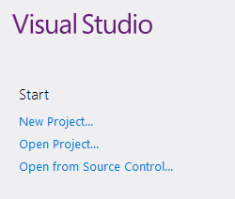
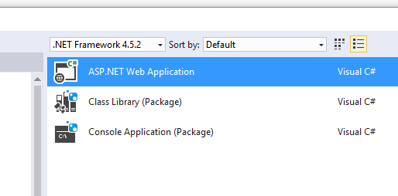
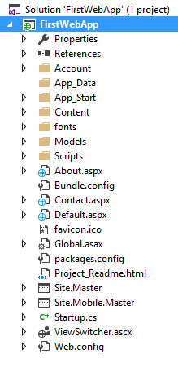
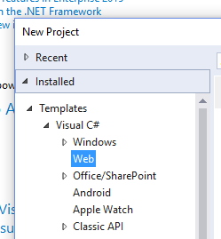
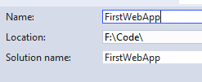
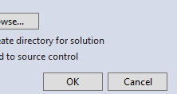
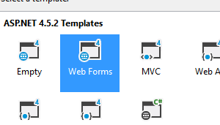
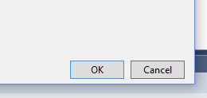
Create Web Application
1
Done
3
4
2
5
6
7

Slide 11
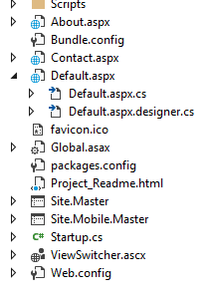

Files
“Form” file
“Form” file
“Form” file (Default.aspx is first page called by a web app.)
Code-Behind file
Designer file (Do not touch this file!)
Image that shows in your browser like this
Application Settings
Page Templates
WebServer Settings

